Slide 1




Hello!
Jason Hertzog
Team Vitality

Slide 2

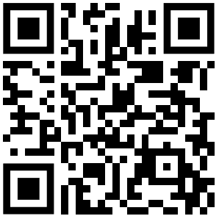
Check out my project on GitHub

Slide 3

Our solution aims to give our patients full control of their own data.
Currently, our patients can control download their data and see it in a dashboard.
In the future, they will be able to see more data and extract data in different formats.

Slide 4
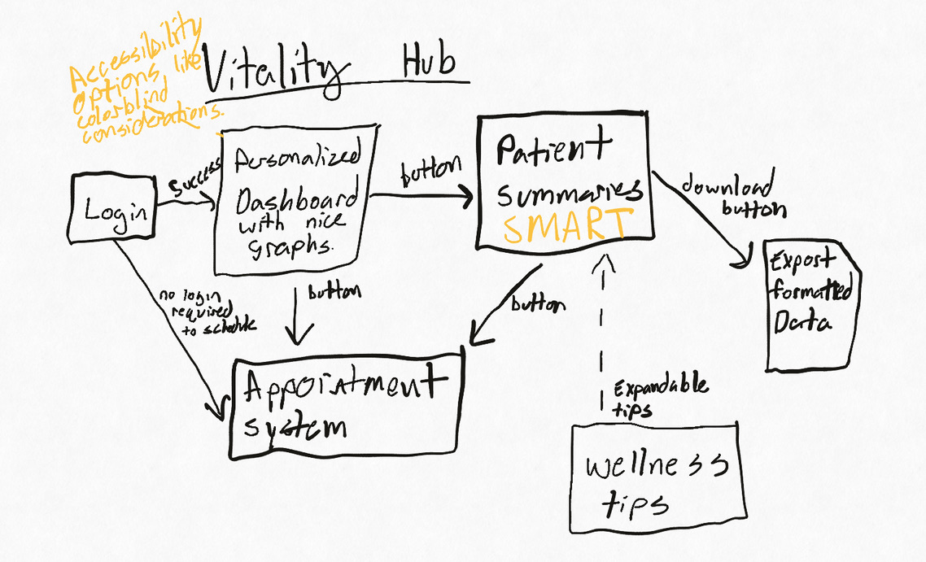
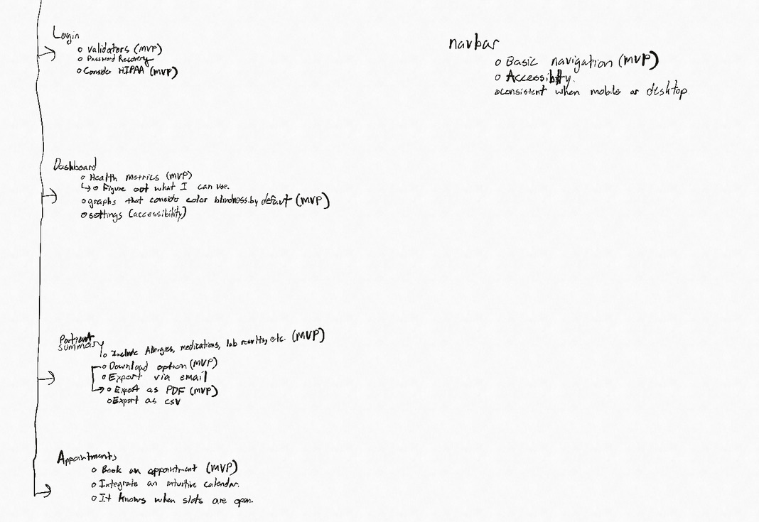
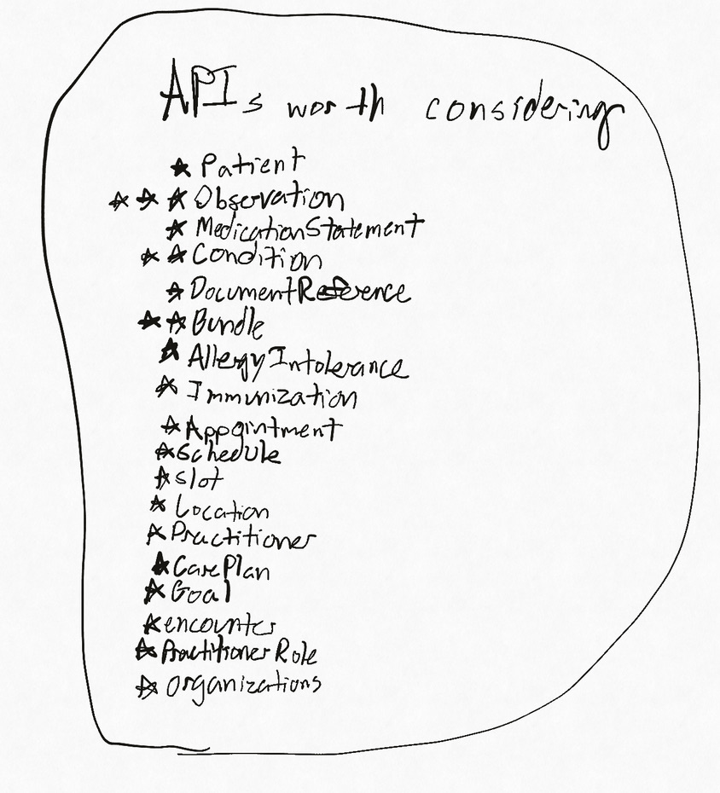
First, there was a plan.
The plan was originally much more grand than it ended up being in the end. Instead of a “Hub” where the user can do everything, Vitality now has a more narrow focus: To give patients visual access to their data, and for them to control what they do with it.

Slide 5
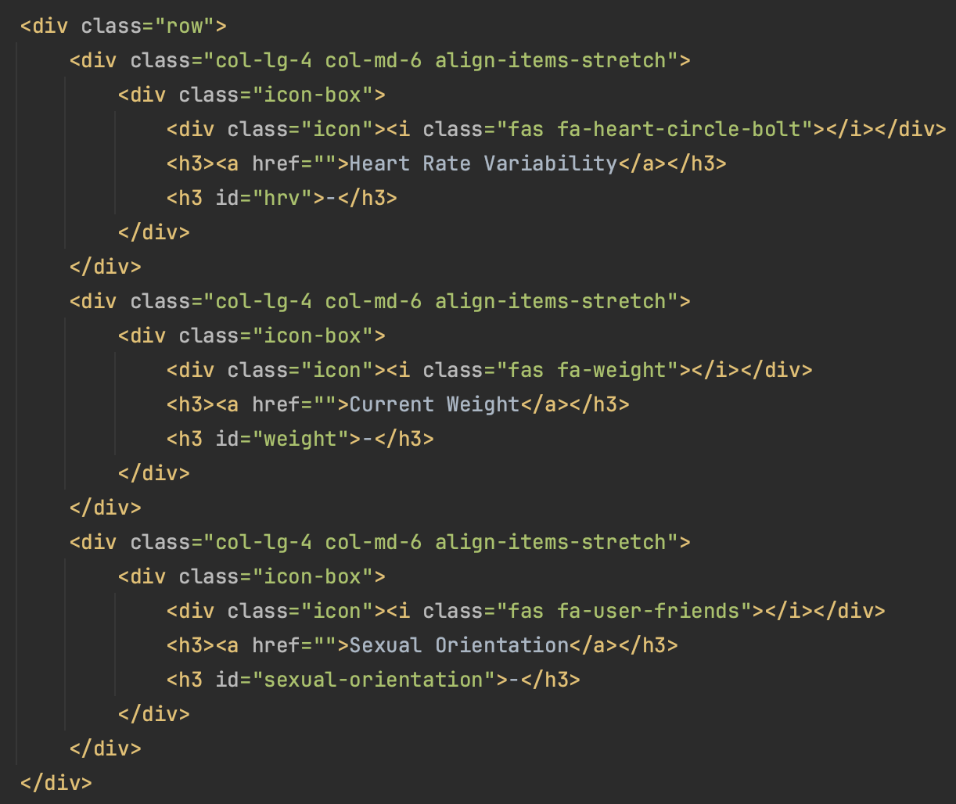
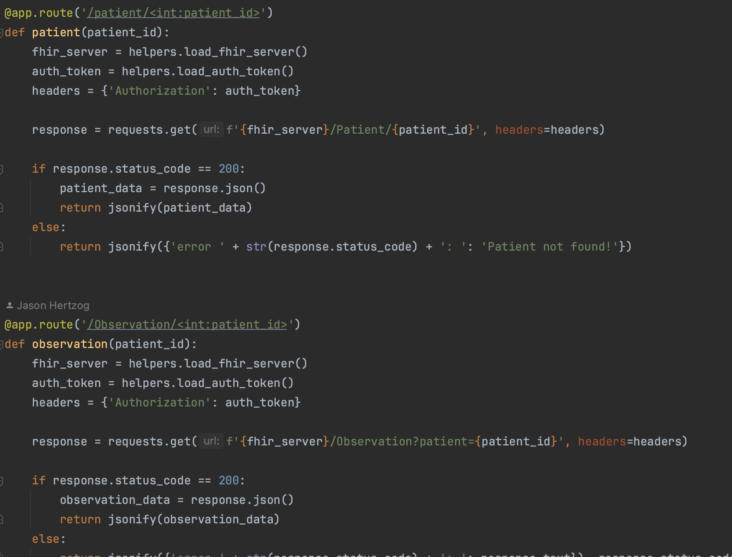
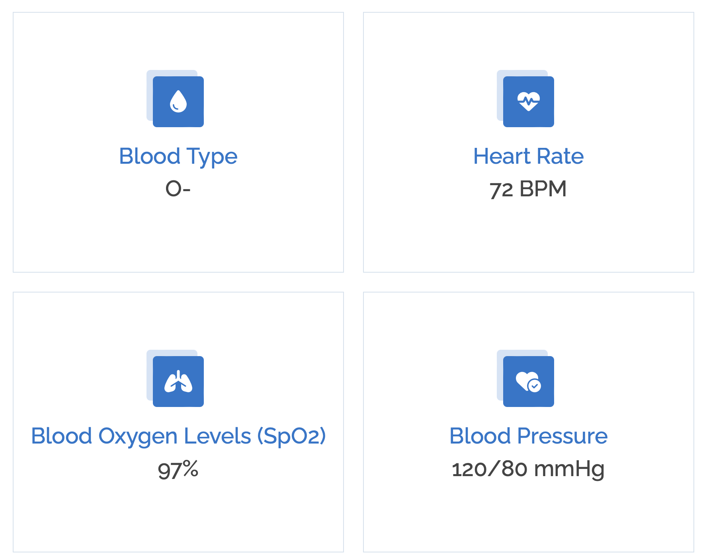
This is how we do it.
Our product makes data sharing easier because it uses HL7 FHIR.
Our product is built to easily scale as our reach increases.
Our product dashboard makes it easy to see our data.

Slide 6
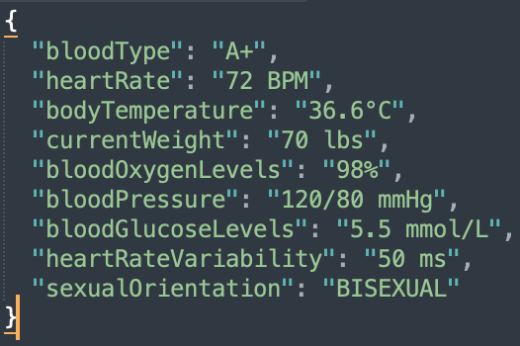
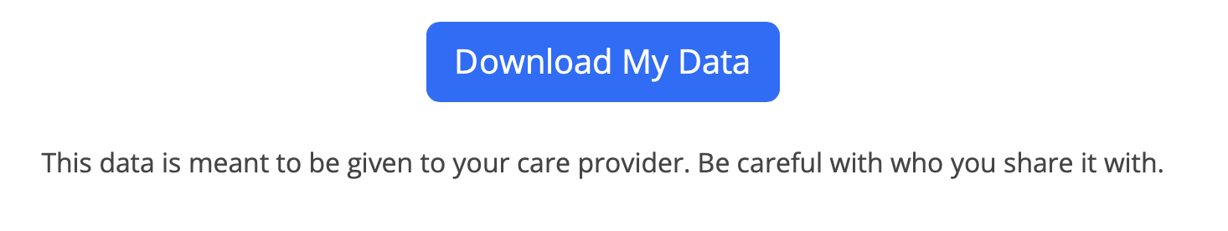
The future is bright
Beautiful Json.
Our patients can download their own data.
That helps their healthcare provider too.

Slide 7
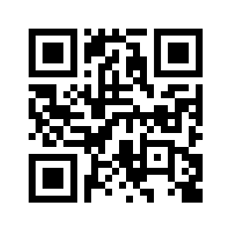
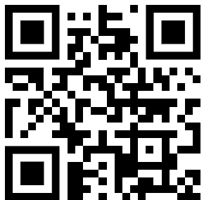
Crafted by
Vitality.
QR Code
HL7 FHIR
Flask
Bootstrap

